Slide 1

Pet Care: Home of Pets
Capstone Project
Done By:
Ahmad Malak
Adam Kanj
Instructor: Dr Nadine Abbas

Slide 2
Identifying Challenges in Modern Pet Care
In today's busy world, pet owners struggle to manage their pets' health and appointments efficiently.
Veterinarians face challenges in maintaining organized schedules and easily accessible medical records.

Slide 3
Identifying Challenges in Modern Pet Care
Our Vet Appointment and Management System is designed to simplify these processes, making pet care more efficient and less stressful for both pet owners and veterinarians.
By integrating with pet shops, we also offer a seamless experience for pet owners to manage all their pet-related needs in one place.

Slide 4
Key Features and Benifits
01
Appointment Scheduling
02
Medical Records Management
03
Pet Shop Integration
04
Admin Controls

Slide 5

A picture is worth a thousand words

Slide 6
Design & Infrastructure
Backend: Our backend is built using ASP.NET Core Web API, providing a robust and scalable foundation for business logic and data processing.
Database: Microsoft SQL ensures secure and efficient data management for medical records, appointments, and product information.
Frontend: We used Flutter for a responsive and user-friendly cross-platform interface that adapts seamlessly to various devices.

Slide 7
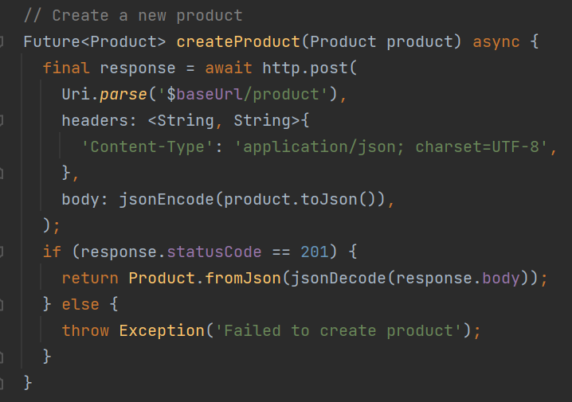
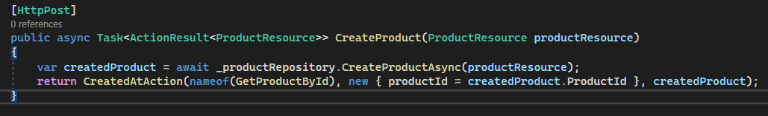
Design & Infrastructure
The frontend, built with
Flutter, communicates with
the backend via RESTful
API calls.

Slide 8
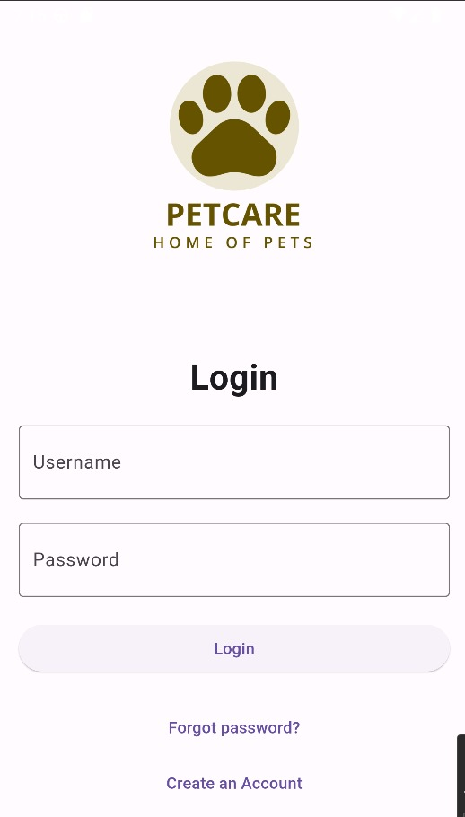
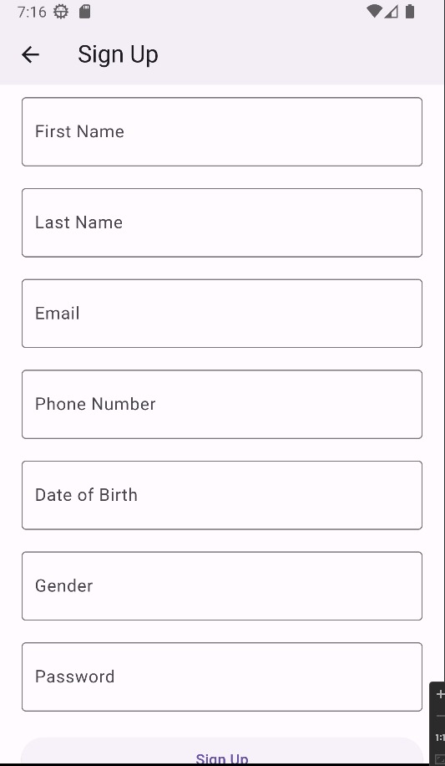
User Authentication
Login page:
Checks if username and password are valid and navigate based on role
Signup page:
Create a user with role “PetOwner”
Password hashing for security

Slide 9

Pet Owner Interface

Slide 10
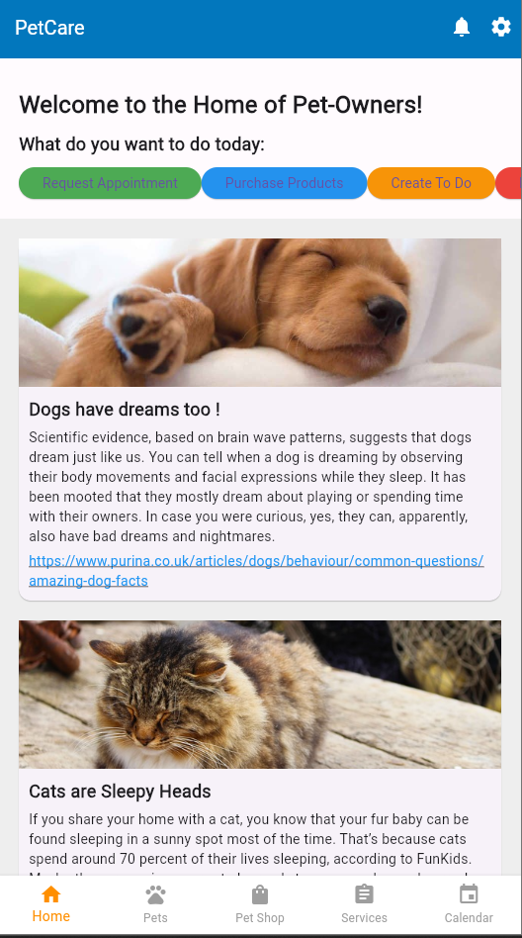
Pet Owner
Pet owners have a
comprehensive dashboard
to manage their:
pets
appointments
purchases

Slide 11
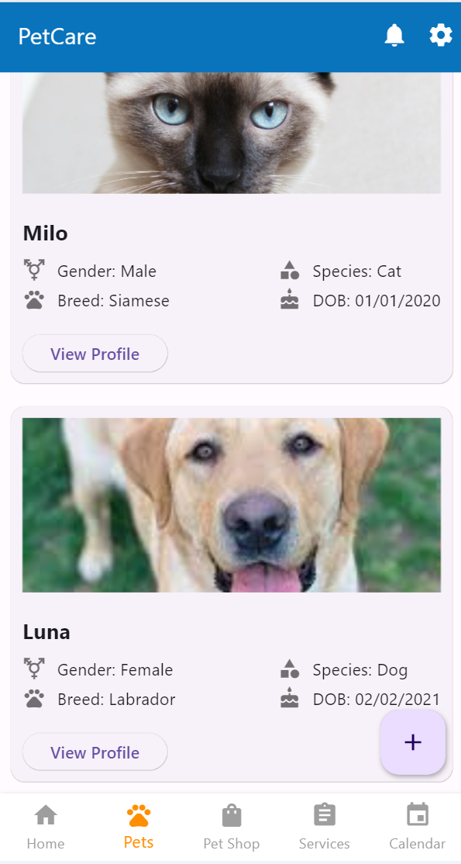
Pet Owner
Displays a list of the user's pets, providing
quick access to detailed profiles and health
records.
List view of pets, with navigation to detailed
pet profiles.

Slide 12
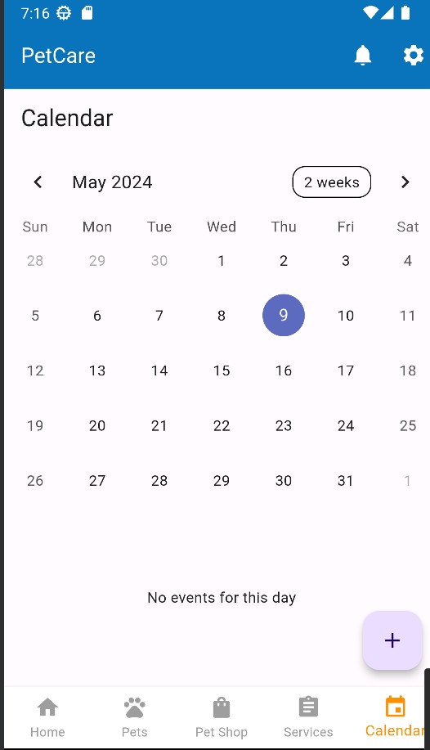
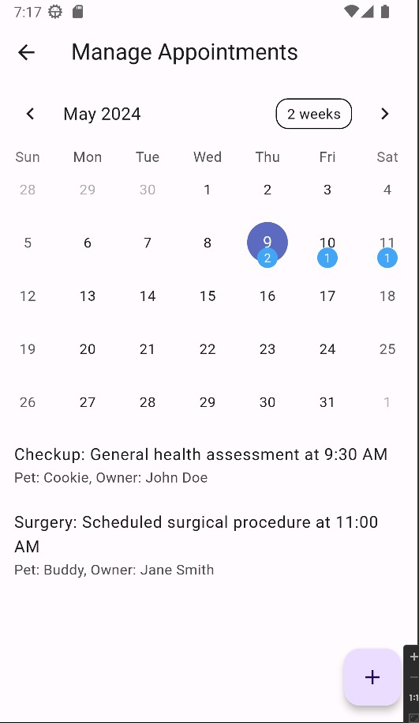
Pet Owner
Manage Appointments
Pet Owner are able to:
Add an appointment
View their appointments in the calender

Slide 13
Veterinarian Interface

Slide 14
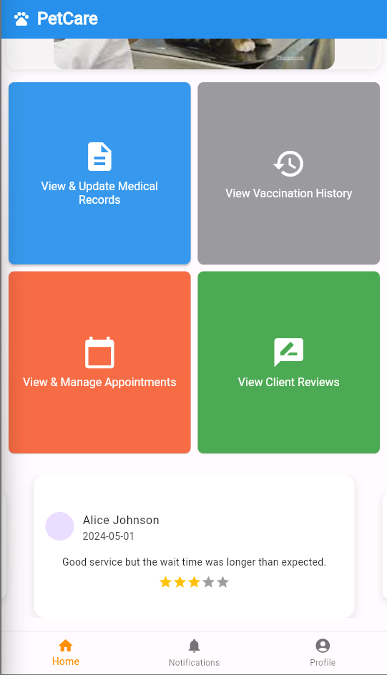
Veterinarian
Veterinarians can:
Manage their appointments
Manage vaccination and medical records
View Clients’ Reviews

Slide 15
Veterinarian
Manage Appointments
Veterinarians are able to:
Add an appointment
View their appointment in the calender
Edit appointments

Slide 16
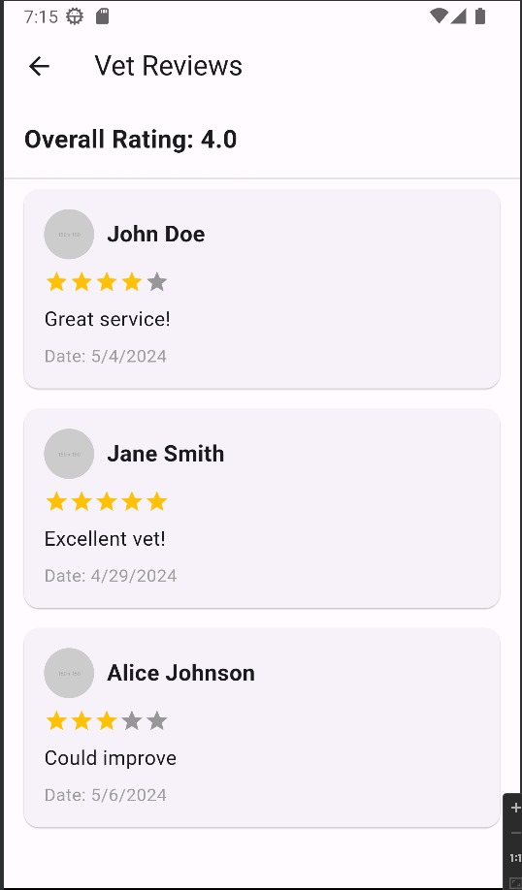
Veterinarian
View Reviews
Veterinarians are able to:
View pet owners reviews and comments
View overall rating

Slide 17
Admin Interface

Slide 18
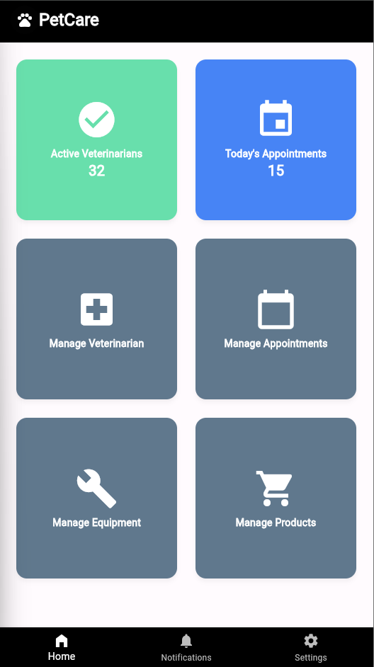
Admin
Veterinarian Interface
Displays a list of the services provided in our
application. Pet owner can choose the service
that he wants and make an appointment.
Rate vet feature that enable pet owners to
rate their experience with the veterinarians.

Slide 19
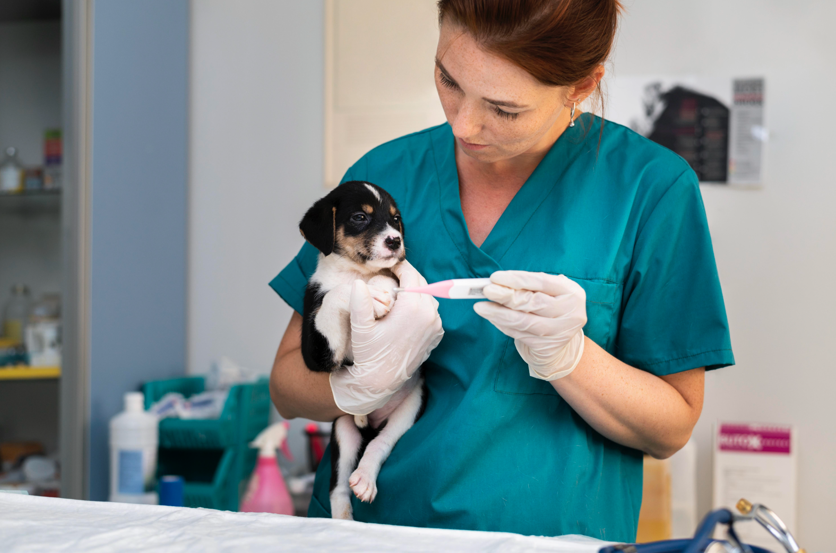
Thank You

